Slide 1
BIG DATA ANALYTICS WITH IBM CLOUD DATABASES
COLLEGE: UNITED INSTITUTE OF TECHNOLOGY COLLEGE CODE :7145
BATCHMATES: GOKULNATH S
LAKSHANA.A
MASANAM M
VISHAL R
RATHISH Y
GUIDE:Mrs.NISHANTHI
DOMAIN:CLOUD COMPUTING

Slide 2
Innovation Challenges
Abstract
Big data’ is massive amounts of information that can work wonders. It has become a topic of special interest for the past two decades because of a great potential that is hidden in it. Various public and private sector industries generate, store, and analyze big data with an aim to improve the services they provide. In the healthcare industry, various sources for big data include hospital records, medical records of patients, results of medical examinations, and devices that are a part of internet of things. Biomedical research also generates a significant portion of big data relevant to public healthcare.
That is exactly why various industries, including the healthcare industry, are taking vigorous steps to convert this potential into better services and financial advantages. With a strong integration of biomedical and healthcare data, modern healthcare organizations can possibly revolutionize the medical therapies and personalized medicine.
One such special social need is healthcare. Like every other industry, healthcare organizations are producing data at a tremendous rate that presents many advantages and challenges at the same time. In this review, we discuss about the basics of big data including its management, analysis and future prospects especially in healthcare sector.

Slide 3
The Data Overload
Every day, people working with various organizations around the world are generating a massive amount of data.
The term “digital universe” quantitatively defines such massive amounts of data created, replicated, and consumed in a single year. International Data Corporation (IDC) estimated the approximate size of the digital universe in 2005 to be 130 exabytes (EB).
The digital universe in 2017 expanded to about 16,000 EB or 16 zettabytes (ZB). IDC predicted that the digital universe would expand to 40,000 EB by the year 2020.
To imagine this size, we would have to assign about 5200 gigabytes (GB) of data to all individuals.
Defining big data
big data’ represents large amounts of data that is unmanageable using traditional software or internet-based platforms.
It surpasses the traditionally used amount of storage, processing and analytical power.
Even though a number of definitions for big data exist, the most popular and well-accepted definition was given by Douglas Laney.
big data’ represents large amounts of data that is unmanageable using traditional software or internet-based platforms.
It surpasses the traditionally used amount of storage, processing and analytical power.
Even though a number of definitions for big data exist, the most popular and well-accepted definition was given by Douglas Laney.
In addition, visualization of big data in a user-friendly manner will be a critical factor for societal development.

Slide 4
Healthcare as a big-data repository
Healthcare is a multi-dimensional system established with the sole aim for the prevention, diagnosis, and treatment of health-related issues or impairments in human beings.
The major components of a healthcare system are the health professionals (physicians or nurses), health facilities (clinics, hospitals for delivering medicines and other diagnosis or treatment technologies), and a financing institution supporting the former two.
The health professionals belong to various health sectors like dentistry, medicine, midwifery, nursing, psychology, physiotherapy, and many others.
Healthcare is required at several levels depending on the urgency of situation. Professionals serve it as the first point of consultation (for primary care), acute care requiring skilled professionals (secondary care), advanced medical investigation and treatment (tertiary care) and highly uncommon diagnostic or surgical procedures (quaternary care).
Electronic health records
It is important to note that the National Institutes of Health (NIH) recently announced the “All of Us” initiative that aims to collect one million or more patients’ data such as EHR, including medical imaging, socio-behavioral, and environmental data over the next few years.
EHRs have introduced many advantages for handling modern healthcare related data. Below, we describe some of the characteristic advantages of using EHRs.
The information includes medical diagnoses, prescriptions, data related to known allergies, demographics, clinical narratives, and the results obtained from various laboratory tests.
The recognition and treatment of medical conditions thus is time efficient due to a reduction in the lag time of previous test results.

Slide 5
Include analytics and innovation in every role
Train employees in analytics: Leaders invest in employee training. In fact, our survey revealed that Leaders are 110 percent more likely to believe in the potential of training their employees in analytics than Strugglers.
As a result, although 67 percent of Strugglers cited insufficient skills as a barrier to innovation, only 42 percent of Leaders did. Westfield Insurance understands the power of training.
As part of an analytics transformation to extract more value from its data, the company created an Analytics Resource Center that conducts regular employee training sessions, made analytics a key competency for all employees and added analytics-related objectives to employee goals.
Use big data and analytic tools for innovation: Leaders are better able to analyze and interpret data, as well as transform it into actionable insights.
For example, an international team of molecular scientists used an analytic crowdsourcing tool to unravel a mystery that had stumped them and more traditional analytic tools for 15 years.
Innovative Products and Services
There are many sectors in which Big Data is making difference, a few to name
are aerospace, biomedicine, Internet of Things (IoT), functional interactions
(human brain), clinical practices, education, vaccinology, social policy, and
many more.
Big data benefits are well understood in data-driven R&D, develop-
ing in goods (products) and services, data-driven processes, data-driven mar-
keting, and developing new organizations i.e. data-driven organizations.
The cost of data storage is very low. Business (private/public) small or large, government departments are moving or already moved their business online.

Slide 6
Business Models Transformations
Business models are often seen as an intermediately between a company’s strategy and its business processes (Morris, Schindehutte, & Allen, 2005).
Big data insights are enabling businesses to innovate business processes and
rethink business models and come up with new strategies.
how strategy is transformed into a business model and then further down into a
business process model.
Companies like GE and Siemens not only selling their electric grids and medical equipment but also their customers beyond regular annual maintenances on how to add value, improved efficiencies applying analytics on data collected from these devices.
Uber and many others are great examples of how mobile devices, cloud technology, and data analytics have disrupted the cab industry all around the world.

Slide 7
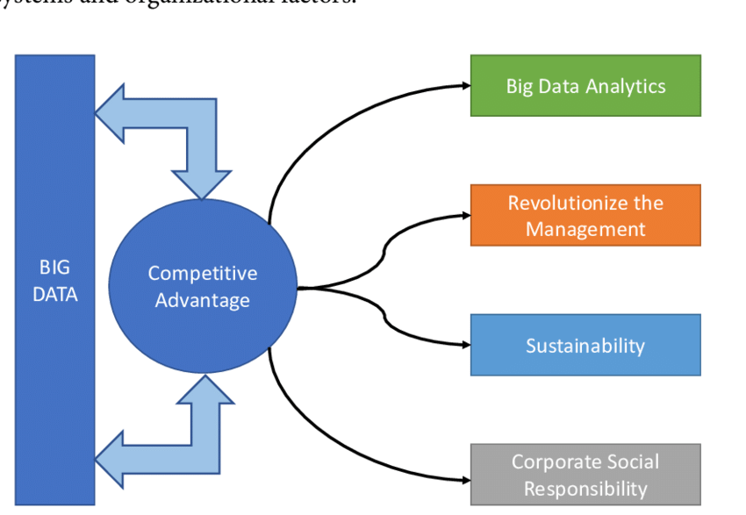
Data-driven competitive advantage
Big data is complex, and it is not easy to draw hidden patterns and identify cor-
relations never been straightforward.
Big data analytics reveal very useful information for businesses,the goal of big data analytics is to get deep and rich in-sights resulting in competitive advantage.
Big data isalready disrupting the established industries and challenging the existing business models

Slide 8
Applications and key data sources for big data and business analytics.
There are various areas of business and industries that have benefited from big data analytics technologies. These areas generate a huge amount of data that require big data analytics process for effective and efficient decision making.
Healthcare: Improved health is important for economic growth, good physical and mental health. Healthcare industry generates a huge amount of data that can be used to enhance decision making by both doctors and other health practitioners. In addition, the use of big data in healthcare can help to develop a real-time analysis of disease thereby improving the quality of life to the public.
Network Optimization: Big data and business analytics approach can be used to design a mobile network to provide efficient services. The area of interest is in content-centric analysis, traffic analysis, network signaling to ensure effective service delivery and quality of service delivery.
User behavior modeling: User behavior modeling helps to understand navigation patterns in order to develop user-centric applications. These applications are important in anomalies, fraud and spam detection in social media and enable social behavior changes for target marketing
Human mobility modeling: Human beings maintain a regular pattern over a period of time. Consequently, repeating such pattern enables efficient prediction of a global movement and this can be applied in disease containment, transportation planning, emergency situation and prevent the outbreak of diseases by leveraging the social network platform, GPS data, call data record and geo-tagged data through big data analytics methods.
Crowdsourcing and Sensing: Crowdsourcing implemented through opportunistic sensing is an essential source of data for data-driven decision making in a business environment. Many companies employ these techniques to enlist people to perform a specific task for solving complex problems by leveraging smartphone with embedded sensors.

Slide 9
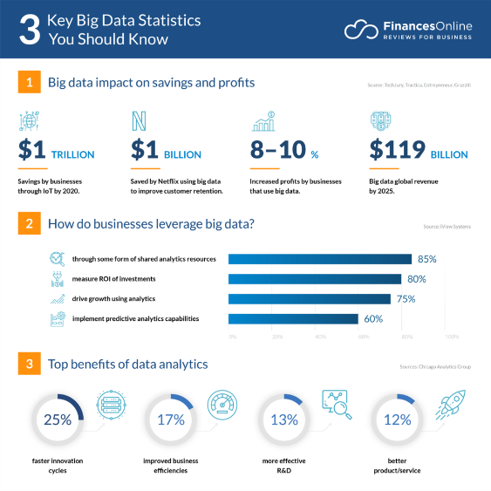
Key trends in innovation and data analytics

